Slide 1
E-COMMERCE CHATBOT
USING LSTM
MURALI KRISHNAN S
REG.NO: 422521104305
r.s.murali0628@gmail.com
University College Of Engineering Villlupuram

Slide 2
AGENDA
01
PROBLEM STATEMENT
02
PROPOSED SYSTEM/SOLUTION
03
SYSTEM RECQUIRMENTS
04
ALGORITHM AND DEPLOYMENT
05
WHO ARE THE END USERS
06
RESULT
07
CONCLUSION
08
REFERENCES

Slide 3


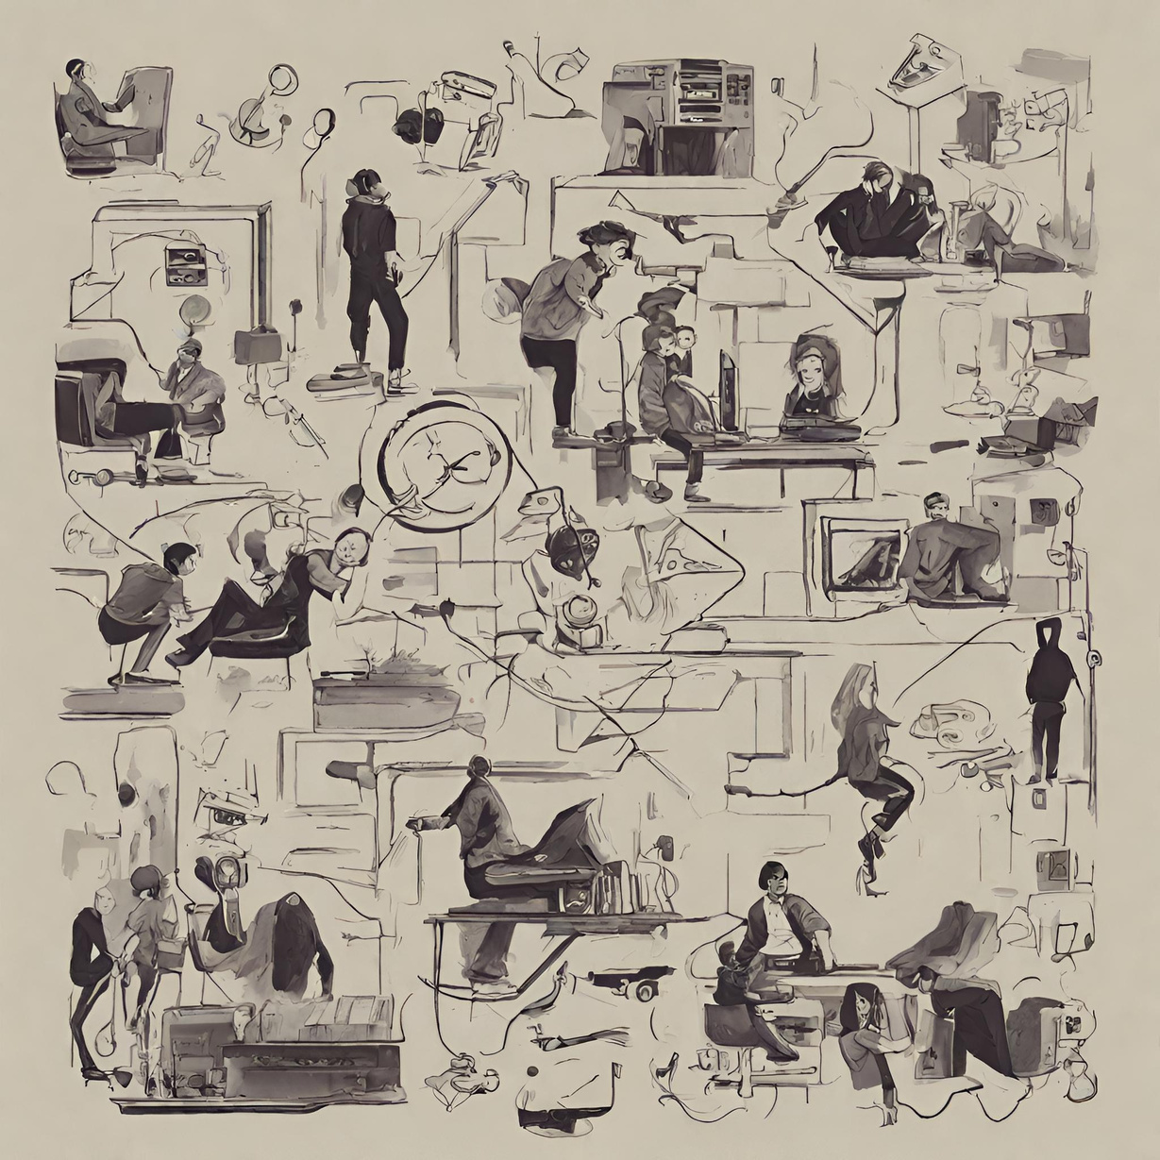


PROBLEM STATEMENT
Addressing the challenges of eCommerce customer support, we've introduced a cutting-edge automated chatbot powered by deep learning methodologies. This innovation revolutionizes customer service by delivering instantaneous, uniform, and budget-friendly support solutions. Our objective is to elevate user satisfaction while optimizing the efficiency of our support operations.

Slide 4
PROPOSED SYSTEM/SOLUTION
DEEP LEARNING MODEL
CHATBOT ARCHITECTURE DEDIGN
Utilize LSTM networks to process and understand the sequential nature of natural
language data effectively. This involves capturing long-term dependencies insequences, facilitating the model's understanding and classification of user queries.
Design a chatbot architecture using LSTM networks for natural language
processing, complemented by text cleaning, tokenization, and intent classification to deliver precise and relevant responses.

Slide 5
PROPOSED SYSTEM/SOLUTION
TEXT PROCESSING
HYPER PARAMETER TUNING
TOKENIZATION AND PADDING
Implement cleaning and organizing of raw text data to ensure clean input for the model. This involves converting text to lowercase, lemmatizing words, and removing stopwords to prepare the text data for model input.
Utilize Keras Tuner to automate the optimization of model parameters to improve performance and accuracy. This involves systematically exploring the hyperparameter space to find the optimal configuration for the model.
Implement tokenization and padding techniques to convert text data into numerical sequences and ensure a consistent input length for the model. This involves tokenizing textual data to convert words into numerical form and applying padding to ensure a uniform sequence length.

Slide 6
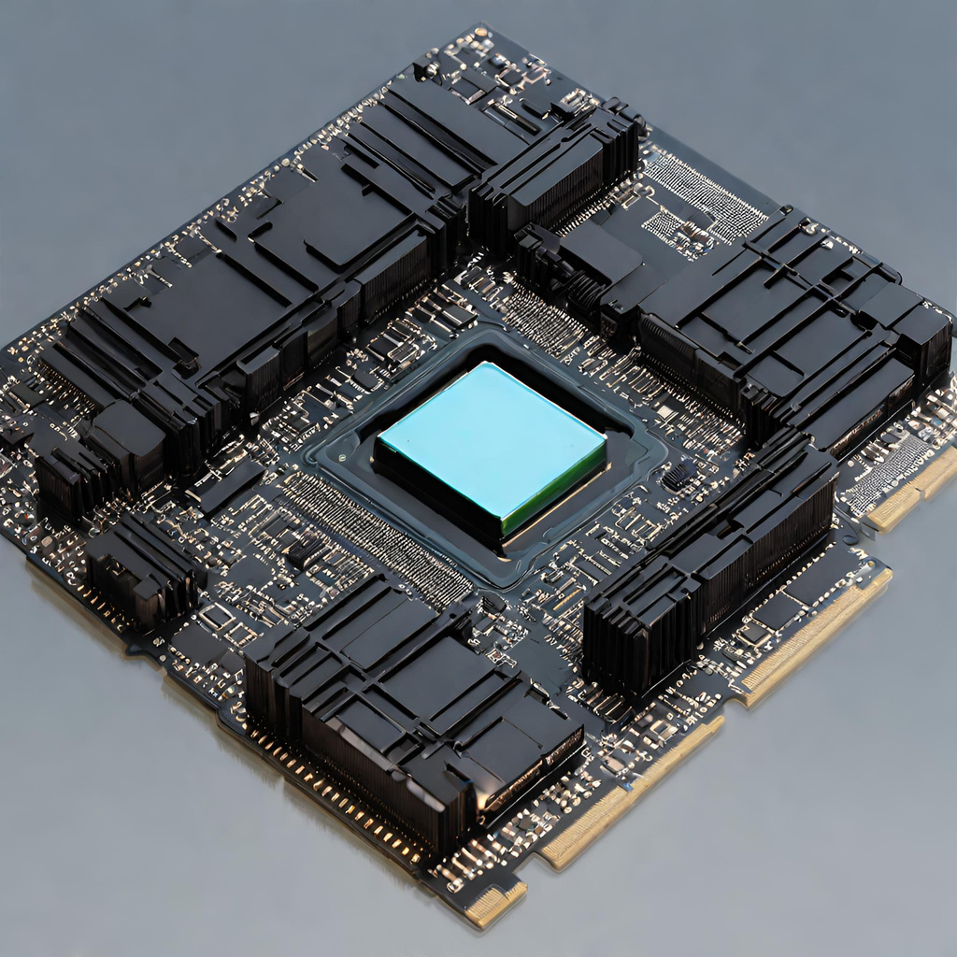
SYSTEM APPROACH
1.HARDWARE
SYSTEM RECQUIRMENTS
CPU: A multicore processor to handle computational tasks efficiently,
supporting the intensive processing demands of deep learning algorithms.
RAM: Minimum of 8GB RAM to ensure smooth performance during model
training and inference, accommodating the memory requirements of large
datasets and complex computations.
Internet Connection: Stable and high-speed internet connection to facilitate
data retrieval, model updates, and seamless interaction with external services
and APIs.

Slide 7
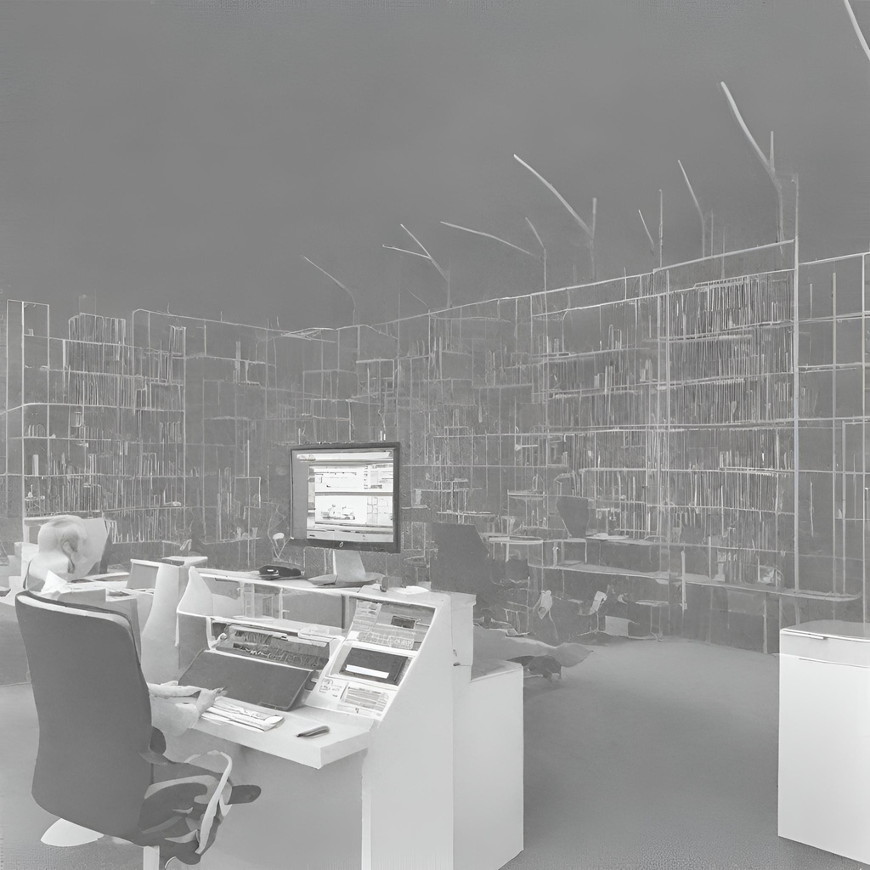
SYSTEM APPROACH
2.SOFTWARE
SYSTEM RECQUIRMENTS
Python: Programming language used for developing the chatbot application.
TensorFlow/Keras: Deep learning libraries used for building and training the
LSTM model.
NLTK: Natural Language Toolkit used for text preprocessing and tokenization.
scikit-learn: Library for various machine learning tasks like data preprocessing
and model evaluation.
Jupyter Notebook: Interactive computing environment used for prototyping,
data analysis, and model development.
Optional: Django for web-based interface (if applicable).

Slide 8

ALGORITHM AND DEPLOYMENT
01
02
03
04
DATA
PREPARATION
TEXT PROCESSING
DEEP LEARNING MODEL:NETWORK
Employed NLTK for text processing to clean and organize raw text data.
Eliminated punctuation and stop words to ensure the input was devoid of irrelevant elements.
Utilized lemmatization to reduce words to their base forms for enhanced analysis.
Acquired the dataset from Kaggle to serve as the foundation for training and evaluating the chatbot model .
Gathered the requisite data from Kaggle to establish the groundwork for both training and testing phases of the chatbot model.
Implemented LSTM networks to handle natural language data processing and comprehension.
Configured the model architecture with two LSTM layers, each comprising 110 units.
Employed the Adam optimizer, setting the learning rate to 0.01 for efficient model training.

Slide 9
ALGORITHM AND DEPLOYMENT
04
05
HYPERPARAMETER TUNING MODELS:TUNER
TOKENIZATION AND PADDING
Utilized Keras Tokenizer to tokenize the text data, transforming words into numerical sequences.
Implemented padding to maintain a consistent sequence length of 200 for model input.
Configured the vocabulary size to 2000 to encompass the most prevalent words in the dataset.
Incorporated an out-of-vocabulary token (OOV) mechanism to manage words not present in the vocabulary during tokenization.
Employed Keras Tuner for automating model parameter optimization.
Varied the number of units in LSTM layers from 50 to 150.
Investigated the range of dense layers in the model from 1 to 20.
Fine-tuned learning rates across 0.01, 0.001, and 0.0001 for enhanced performance.

Slide 10


DEPLOYMENT
JUPYTER NOTEBOOK
The chatbot code is hosted on GitHub by implementing the main code directly on a Jupyter Notebook. This approach allows for easy viewing and execution of the code.
2. DJANGO WEB APPLICATION
The chatbot is presented as a user-friendly web-based interface using the Django framework and hosted on GitHub. This method offers a seamless user experience and makes the chatbot accessible via a web browser.

Slide 11
WHO ARE THE END USERS?
Online Shoppers: Individuals seeking product information, recommendations, or assistance during their shopping journey.
Customer Support Teams: Team members tasked with addressing customer inquiries and delivering prompt, precise responses.
Website Visitors: Potential customers browsing the eCommerce platform, possibly in need of guidance or information.
Technical Support: IT professionals or developers responsible for maintaining and optimizing the chatbot's functionality and performance.

Slide 12
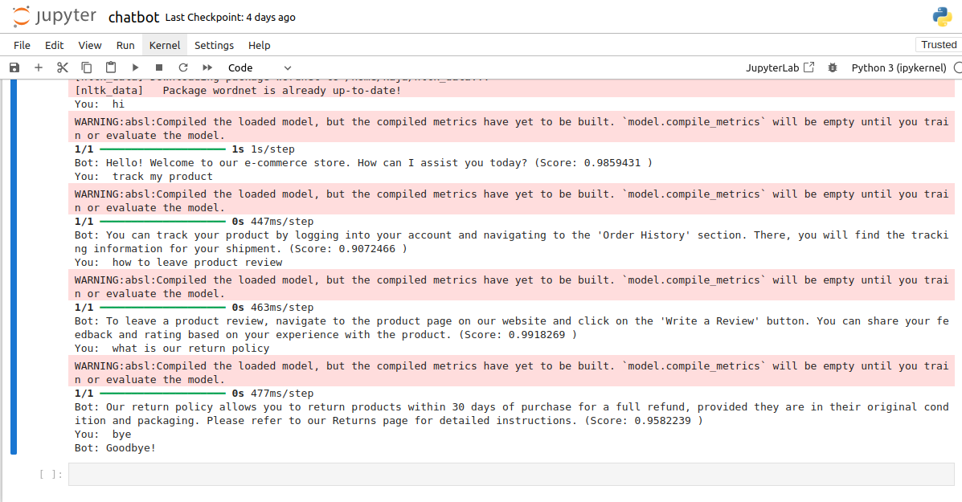
RESULT:
EXECUTED ON JUPYTER

Slide 13
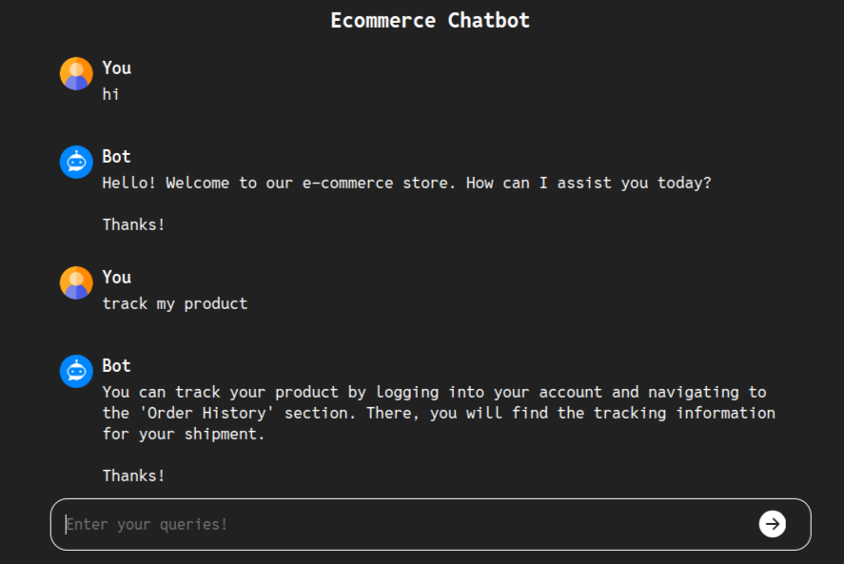
RESULT:
IMPLEMENTED ON DJANGO

Slide 14
CONCLUSION
-Our eCommerce chatbot leverages advanced AI to deliver personalized customer support, enhancing the shopping experience and providing a competitive edge in the digital marketplace.
-As AI technologies continue to advance, our chatbot is poised to evolve and offer even more innovative solutions to meet the changing demands of the eCommerce industry.

Slide 15

REFERENCES
1.NumPy : https://numpy.org/
2.TensorFlow : https://www.tensorflow.org/
3.Keras : https://keras.io/
4.scikit-learn (sklearn) : https://scikit-learn.org/stable/
5.NLTK (Natural Language Toolkit) : https://www.nltk.org/
6.Keras Tuner : https://keras.io/keras_tuner/
7.Pickle (Python's standard library) : https://docs.python.org/3/library/pickle.html
8.Django : https://www.djangoproject.com/

Slide 16
Thank you!

